Slide 1
C Compiling with gcc
HGU

Slide 2

Lab-1: Remote Login to Our Server
Local : WIndows or MacOS Machine (Laptop computer)
Remote : Linux Server
ssh command
C:\>ssh <user_name>@<remote_machine_address>
<user_name> : your student number
<remote_machine_address>: peace.handong.edu
ex) ssh yk@peace.handong.edu
local machine1
(macOS)
local machine1
(windows)
local machine1
(windows)
user3
user1
remote machine
(Ubuntu)
local machine1
(Linux)
local machine2
(windows)
user2
root

Slide 3
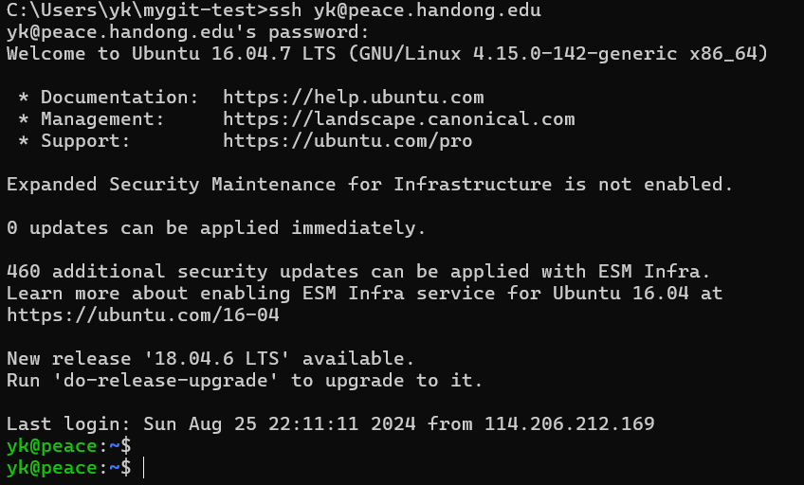
Connecting Linux Server in Windows Command Line
Each Student Password should be changed at the first login
Windows command
(ssh)
Login Welcome Message from Linux System
prompt($) from Linux shell
Your login id and password will be sent individually by personal email.

Slide 4
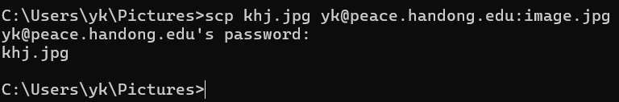

Lab-2: How to transfer files to/from remote host
local에서 원격 host로 파일 보내기(scp)
scp <source-file> <user_id>@<remot-host>:<target-file>
원격 host에서 local로 파일 가져오기(scp)
scp <user_id>@<remot-host>:<source_file> <target-file>
local
(windows)
remote
(linux)
remote
(linux)
local
(windows)

Slide 5
Text editor in Linux
ed : line editor
vi : visual editor
vim : modified vi (allows arrow key)

Slide 6
vi Screen Editor mode
insert mode
i, a, o
ESC
LINUX
Shell
command mode
$vi
:
last line mode
Enter, ESC
wq, q!
command mode : navigate, delete, copy, paste, and do a number of other tasks—except entering text.
insert mode : entering text (contents)
last line mode : reading/writing file to filesystem or setting (configuration) editor

Slide 7
Writing C Source using vi editor
Starting Vim in Shell
Open a file: $ vi filename.c
Vim starts in Normal mode as default - edit text or enter commands
Saving and Exiting in Command Mode
Save the file :w
Exit without saving :q!
Save and exit :wq

Slide 8
Insert Modes of vi
Insert mode - Write the hello.c prints out “Hello World!”
#include <stdio.h>
int main() {
printf(“Hello |W”);
.
return 0;
}
printf(“Hello |World!\n”);
a
Current Cursor Position
i
o
i
printf(“Hello welcomeW”);
a
o
printf(“Hello W”);
printf(“orld”);
Notes:
대문자 capital

Slide 9

Nevigating in Command mode
one character movement
h : left
j: down
k: up
l: right
page movement
^F : forward (next page)
^B : backward (previous page)

Slide 10
Deleting
To delete something you must be in Command mode
x: Deleting a character under cursor
X: deleting a character before cursor
dd: Deleting a line
D: Deleting current cursor to the end-of-line
u : Undo deleting
repeating u: repeating undo in some depth

Slide 11
Tips
A : append-end-of-line
I: insert-beginning-of-line
O: open previous line
yy : copy the line in a buffer
p : print the buffer to current cursor position
r : replace a single character under cursor with a single character
s : substitute a single character under cursor with any characters until ESC
number + command : repeat the command by the number

Slide 12
vim
←↑↓→
move
insert mode
i, a, o
ESC
LINUX
Shell
$vi
command mode
:
last line mode
Enter, ESC
wq, q!
Arrow keys (up,down,left,right) in insert mode for navigation
←: ESC + h + i
↓: ESC + j + i
↑: ESC + k + i
→: ESC + l + i

Slide 13
Compiling C Source
Compilation Steps
Preprocessing directives such as #define and #include
Compilation translates the source code to assembly code (.s)
Assembly converts the assembly code into relocatable binary object code (.o)
Linking creates a executable file from relocatable binaries (.o) and libraries (.a or .so)
Pre-processing
Compilation
Assembly
Linking
Source Code
(*.c)
Preprocessed Source Code
(*.i)
Assembly File
(*.s)
Object File
(*.o)
Executable File
(a.out)
Header File
(*.h)
Object File
(*.o)
Library
(*.a, *.so)
Notes:
-Og : -O1 수준의 최적화를 수행하되, 디버깅 정보의 손실을 최소화하여 디버깅에 최적화됨
-Os : -O2 수준의 최적화 중에서 실행 파일 크기를 증가시키는 최적화를 제외한 최적화 적용.
-Ofast : -O3 수준의 최적화와 함께 IEEE 표준을 무시하는 최적화도 포함하여 성능에 올인.

Slide 14
Compiling C Source
Compilation Steps
Pre-processing
Compilation
Assembly
Linking
Source Code
(*.c)
Preprocessed Source Code
(*.i)
Assembly File
(*.s)
Object File
(*.o)
Executable File
(a.out)
Header File
(*.h)
Object File
(*.o)
Library
(*.a, *.so)
Compilation Steps | GCC Command Example | Description
Preprocessing | $ gcc -E myprog.c | Prints preprocessed code onto terminal
Compilation | $ gcc -S myprog.c | Generates assembly code (myprog.s)
Assembly | $ gcc -c myprog.s | Generates object code (myprog.o)
Linking | $ gcc myprog.o –o myprog | Links and generates executable (myprog)
Disassemble | $ objdump -d myprog.o | Prints disassemled code of myprog.o on terminal
Notes:
-Og : -O1 수준의 최적화를 수행하되, 디버깅 정보의 손실을 최소화하여 디버깅에 최적화됨
-Os : -O2 수준의 최적화 중에서 실행 파일 크기를 증가시키는 최적화를 제외한 최적화 적용.
-Ofast : -O3 수준의 최적화와 함께 IEEE 표준을 무시하는 최적화도 포함하여 성능에 올인.

Slide 15
Linux Executable and Linkable Format (ELF)
ELF: a common standard file format for executable files, object code, shared libraries, and core dumps.
used extensively in Unix-like operating systems including Linux
There are 3 main ELF object files
Relocatable File is an object file generated from source code (.o files)
Shared Object File containing code and data that can be used by multiple programs (.so files)
Executable File is generated by linking together Relocatable Files and Shared Object Files
Core Dumps
Notes:
-Og : -O1 수준의 최적화를 수행하되, 디버깅 정보의 손실을 최소화하여 디버깅에 최적화됨
-Os : -O2 수준의 최적화 중에서 실행 파일 크기를 증가시키는 최적화를 제외한 최적화 적용.
-Ofast : -O3 수준의 최적화와 함께 IEEE 표준을 무시하는 최적화도 포함하여 성능에 올인.

Slide 16
Linux ELF Layout
ELF Header:
file type(executable, shared library, object), target architecture, entry point address,
size and offset of other sections
Program Header:
information of the file’s segmentations which defines how to create a process image into memory (For each segment, type, virtual address , size and permission)
ELF Header
Program Header Table
.text
.rodata
…
.data
Section Header Table
$ readelf –h <file>
$ readelf –l <file>
Section Header Table:
information about various Sections: executable code (.text), red-only data (.rodata), initialized global data (data),uninitialized data (.bss),
symbol table section for function, variables
$ readelf –S <file>
Notes:
-Og : -O1 수준의 최적화를 수행하되, 디버깅 정보의 손실을 최소화하여 디버깅에 최적화됨
-Os : -O2 수준의 최적화 중에서 실행 파일 크기를 증가시키는 최적화를 제외한 최적화 적용.
-Ofast : -O3 수준의 최적화와 함께 IEEE 표준을 무시하는 최적화도 포함하여 성능에 올인.

Slide 17
Libraries in Linux
C library consists of two parts
Application Programming Interface (API) defined in header text files (.h)
Implementation usually provided as precompiled binary files (.a, .so)
Two types of Library
Static Library is an archive(single binary file) of object files (.a files)
Dynamic Library is loaded during the runtime (.so files)
Shared Library uses the object file built with PIC (Position Independent Code)

Slide 18
PIC
Position Independent Code (PIC) is a type of machine code that executes correctly regardless of its absolute address.
The code can be relocated to any address without needing changes.
Dynamic Libraries designed to support PIC have been referred to as shared libraries
As 64-bit systems’ compilers strongly prefer PIC, the distinction between dynamic libraries and shared libraries has faded and the terms are now almost synonymous
Notes:
Benefits of PIC
- Efficient use of 64-bit address space
- Shared Libraries and Code reusability
Optimization and Performance
Efficiency to manage memory
- Enhanced Security
* How to make PIC?
1. Compiling with pIC
gcc -fPIC -c mycode.c -o mycode.o
2. Linking PIC
gcc -shared -o libmylibrary.so mycode.o
3. Using PIE (Position-Independent Executable)
gcc –fPIE –pie -o myprogram mycode.c
4. Checking for PIC
readelf –h mycode.o
or objdump –r mycode.o
* Understanding how PIC works:
PIC works by using relative addressing rather than absolute addressing. This means that code accesses data and functions relative to the current instruction pointer rather than relying on fixed memory addresses.
For example, when calling a function or accessing global variables, the addresses are computed based on offsets from the current position in the code rather than hardcoded addresses.
* GTO (GLobal Offset Table)
PIC code often uses the GOT to store the absolute addresses of global variables and functions. At runtime, the dynamic linker populates the GOT with the correct addresses based on where the code has been loaded.
PLT (Procedure Linkage Table)
* Summary:
Implementing PIC involves using specific compiler and linker flags (-fPIC, -shared, -fPIE, and -pie) during the build process. PIC allows code to execute correctly regardless of where it is loaded in memory, which is essential for security features like ASLR and for efficient use of shared libraries in 64-bit systems.

Slide 19
Static Library (.a)
Is a collection of object files called archive(.a)
Linker extracts needed object files from archive and attaches them to program file
When linker encounters an archive in command line, it searches the already passed objects to see if there is a reference to objects in this archive or not
Notes:
-Og : -O1 수준의 최적화를 수행하되, 디버깅 정보의 손실을 최소화하여 디버깅에 최적화됨
-Os : -O2 수준의 최적화 중에서 실행 파일 크기를 증가시키는 최적화를 제외한 최적화 적용.
-Ofast : -O3 수준의 최적화와 함께 IEEE 표준을 무시하는 최적화도 포함하여 성능에 올인.

Slide 20
Shared Library(.so)
Is also a collection of objects
When it is linked into another program, the program does not contain the whole object, but just references to the shared library
Is not a collection of object files, but a single big object file which is a combination of object files
Shared Libraries are Position Independent Codes, because the function in a .so, may be loaded at different addresses in different programs
Notes:
-Og : -O1 수준의 최적화를 수행하되, 디버깅 정보의 손실을 최소화하여 디버깅에 최적화됨
-Os : -O2 수준의 최적화 중에서 실행 파일 크기를 증가시키는 최적화를 제외한 최적화 적용.
-Ofast : -O3 수준의 최적화와 함께 IEEE 표준을 무시하는 최적화도 포함하여 성능에 올인.

Slide 21
Shared Library
The Linker just includes the name of the “.so” in executable file
The OS is responsible to find the specified “.so” file
By default, system searches only “/lib” and “/usr/lib”
Programmer can indicate another path by setting the LD_LIBRARY_PATH environment variable or referring the directory path in gcc command line through -L option
Notes:
-Og : -O1 수준의 최적화를 수행하되, 디버깅 정보의 손실을 최소화하여 디버깅에 최적화됨
-Os : -O2 수준의 최적화 중에서 실행 파일 크기를 증가시키는 최적화를 제외한 최적화 적용.
-Ofast : -O3 수준의 최적화와 함께 IEEE 표준을 무시하는 최적화도 포함하여 성능에 올인.

Slide 22
Compiling with Libraries
How to Build Static Library
How to Build Dynamic Library
GCC Command Example
$ gcc -c foo.c -o foo.o $ ar rcs libfoo.a foo.o # Build static library (libfoo.a) # ar rcs is used to create, update the archive from the specified files $ gcc main.c -L. -lfoo # -lfoo is a alias of libfoo.a # -L specify a directory where the linker should look for libraries
GCC Command Example
$ gcc -fPIC -o foo.o -c foo.c # -fPIC is needed to build object file as PIC $ gcc -shared -o libfoo.so foo.o # -shared builds shared library (libfoo.so) $ gcc myprog.c -L/lib -lfoo # -lfoo is a alias of libfoo.so # -L specify a directory where the linker should look for libraries
Notes:
-Og : -O1 수준의 최적화를 수행하되, 디버깅 정보의 손실을 최소화하여 디버깅에 최적화됨
-Os : -O2 수준의 최적화 중에서 실행 파일 크기를 증가시키는 최적화를 제외한 최적화 적용.
-Ofast : -O3 수준의 최적화와 함께 IEEE 표준을 무시하는 최적화도 포함하여 성능에 올인.

Slide 23
Compiling with Libraries
How to Build with Libraries
Why does the command need -I and -L Options?
Compiler searches the header files at current directory and system standard directories (such as ‘/usr/include’)
Linker searches the libraries in the same sequence (‘./’, ‘/usr/lib’)
-I and -L option tells to the compiler and linker to add specific directory to the list of searching directories
GCC Command Example
$ gcc main.c -I/include -L/lib -lfoo # -lfoo is a alias of libfoo.s # -L specify a directory where the linker should look for libraries # -I specify a directory where the linker should look for header files
Notes:
-

Slide 24
Compiling with Libraries
How to Build with Libraries
How does the system known -lfoo is static or shared library?
Priority of shared library(.so) is higher than static library(.a) unless explicitly specified
(-static option in gcc command line for explicitly specification)
GCC Command Example
$ gcc main.c -I/include -L/lib -lfoo # -lfoo is a alias of libfoo.s # -L specify a directory where the linker should look for libraries # -I specify a directory where the linker should look for header files
Notes:
-Og : -O1 수준의 최적화를 수행하되, 디버깅 정보의 손실을 최소화하여 디버깅에 최적화됨
-Os : -O2 수준의 최적화 중에서 실행 파일 크기를 증가시키는 최적화를 제외한 최적화 적용.
-Ofast : -O3 수준의 최적화와 함께 IEEE 표준을 무시하는 최적화도 포함하여 성능에 올인.

Slide 25
Reference
https://www.vim.org/
https://diveintosystems.org/book/C2-C_depth/advanced_libraries.html
https://diveintosystems.org/book/C2-C_depth/advanced_writing_libraries.html
https://www.slideshare.net/slideshow/advanced-c-programming-in-linux/85064690#8

